Slide 1

Lab Maintenance Query Portal
Suraj Singh 20104032
Himanshu Rane 20104008
Atharva Takle 20104022
Project Guide
Prof. Neha Deshmukh

Slide 2
Contents
Introduction
Objectives
Scope
Literature Survey
Proposed System
Project Outcomes
Block Diagram
Use Case/DFD
Technology Stack
Suggestions in Review-1
Result and Discussion
Conclusion and Future Scope
References

Slide 3
1. Introduction
Lab Maintenance Query portal (LMQP) is a platform where lab in charges can post their complaint or raised the tickets.
Maintenance staff can view and solve their queries.
Admin will be able to view the complaints or tickets posted and their resolution.
The stakeholders will be able to keep the track of the complaints or tickets raised.

Slide 4
Continued…
Problem Identified :
    Many of the lab complaints remained unsolved.
    It becomes difficult to maintain physical deadstock register.
    It becomes difficult for admin to track the resolution of the queries.
Solution Proposed :
    Lab In charges can post their complaints with proper information.
    Maintenance team get accurate information about the query and able to provide solution of it.
    Admin can be able to view the no of Queries registered and solved.

Slide 5
2. Objectives
To build an user friendly transparent web based application to ease the process of registering complaints or raising the tickets.
To maintain the record of registered complaints or tickets.
To ease the work of maintenance staff.
To view the status of complaints or tickets being processed
To update the status of the query.
To ease the process of maintaining records.

Slide 6
3. Scope
Can be applied in Educational institutes like school and colleges
Can also be applied in offices, IT companies or firms.
Can be used to avoid tedious offline work and IT lab maintenance process can be streamlined.

Slide 7
4. Literature Survey
Complaint management system (Ref: IRJET-V414143):
The complaint management system is a web-based and it is designed to keep track of complaints registered by college, department and lab staff.
Tech stack used: ASPNET, HTML, CSS
Smart Complaint Management System (Ref: ISPC2018):
This is a mobile app with chat box and web application for problem resolution of query posted by customers.
This is a ML based project.
Agent-based Complaint Management System (Ref: IRJESM-V2I4):
Complaint Management System is a system to enable customers channel the issues about the organization for immediate action.
Thus responsive complaint system is essential for the organization to ensure customers satisfaction in managing complaints.

Slide 8
5. Proposed System
All Users Login Page
The page where system users will submit their credentials to access the data and functionalities of the system.
Dashboard Page
The page where the system users will be redirected by default after logging into the Lab Maintenance Query Portal.
New Ticket or query Page
The page where can system users create a new ticket. The admin or support staff has a custom field because this feature is based on users encountered issues with the product.
Manage Ticket or query
This feature includes View, Edit, and Delete. The admin and support staff are permitted to update the status of the ticket.

Slide 9
Continued…
Manage Account Modal
The popup modal where the system users update their system credentials such as their email and password.
Admin Side Only User Page
The page where the admin can manage the list of customers.
Maintenance Staff Page
The page where the admin can manage the list of staff and or remove staff.

Slide 10
6. Outcome of Project
Only Lab in-charges or users , maintenance staff and admin can use the portal.
Users can raise the query or ticket related to lab using options provided.
Maintenance staff will be able to easily locate raised complaints or ticket on the portal.
Admin will be able to view the raised complaints or tickets.

Slide 11
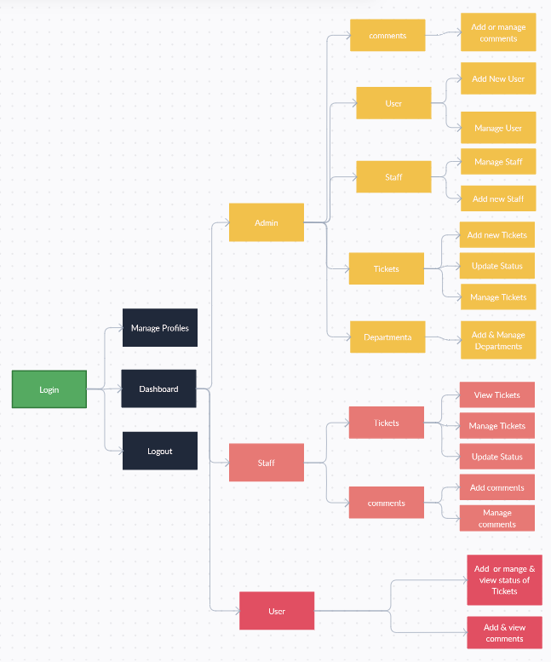
7. System Architecture

Slide 12
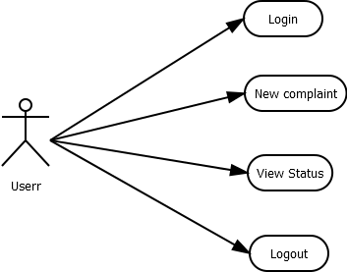
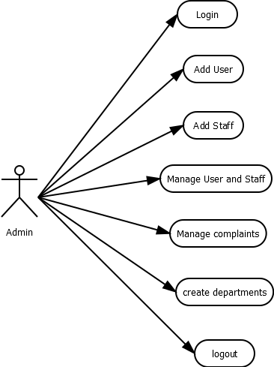
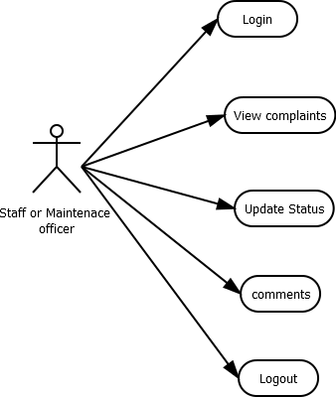
8. Use Case Diagram

Slide 13
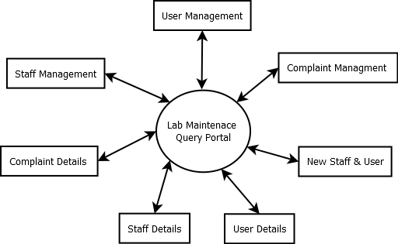
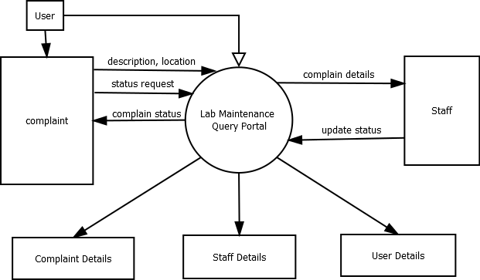
Continued…
Data Flow Diagrams
Level 1 DFD
Level 0 DFD

Slide 14
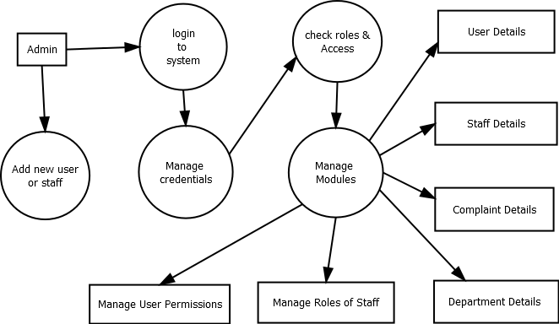
Continued…
Data Flow Diagrams
Level 2 DFD

Slide 15
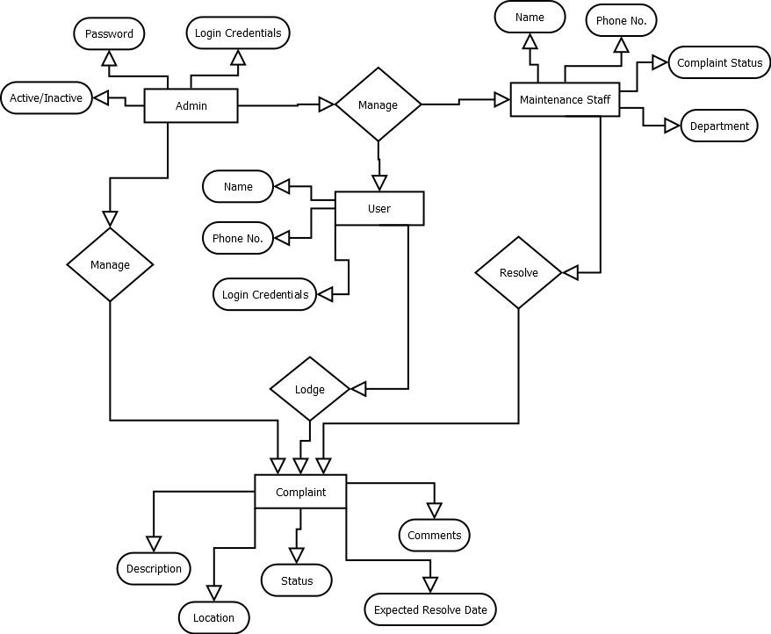
Continued…
E-R Diagram

Slide 16
9. Technology Stack
Development: VS code
Language Used: PHP
Database Used: My SQL
Design Interface: Bootstrap JavaScript, HTML, CSS
Browser: Opera Mozilla, Google Chrome IE8 or any other Brower
Software: XAMPP

Slide 17
10. Suggestions in Review-1
Report generation
Admin can able to generate report of the raised tickets which will give a detailed view about queries solved and unsolved for future references.
Flags
Admin can be able to view unsolved queries directly through the flags. These flags can be seen on homepage at info section.

Slide 18
11. Result and Discussion
LMQP benefits a in a variety of ways. While the benefits vary by department or industry, six benefits of LMQP platforms that affect every user include:
Trustworthy reporting
Dashboards that visually showcase data
Proactive service.
Efficiency
Simplified collaboration.

Slide 19
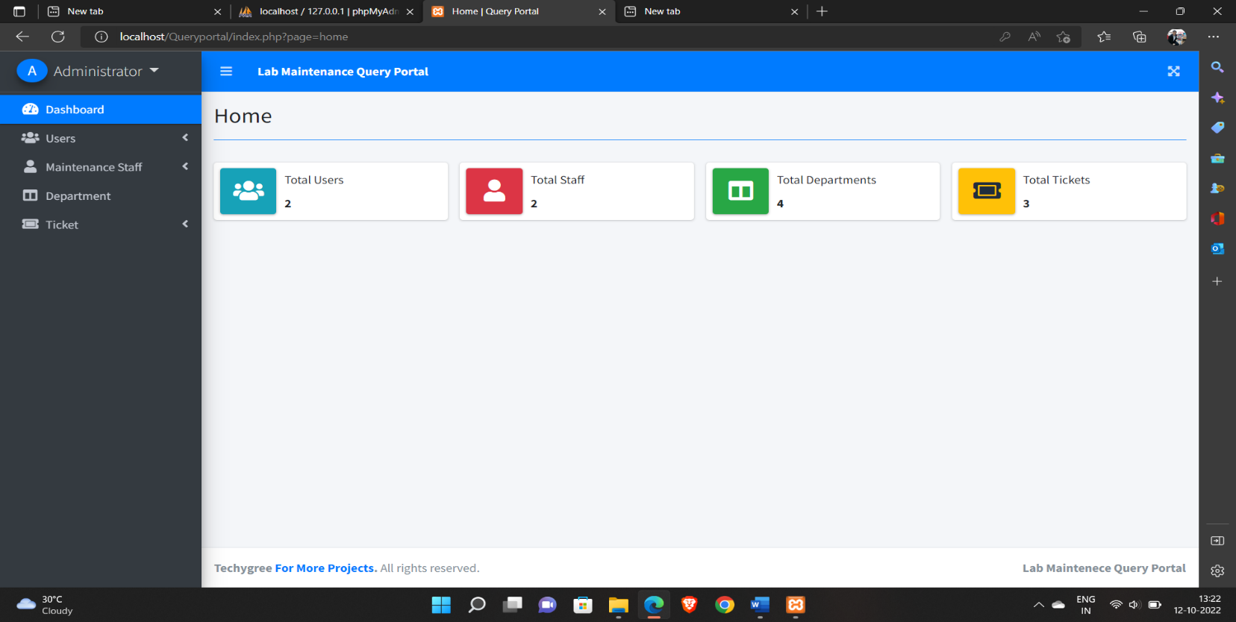
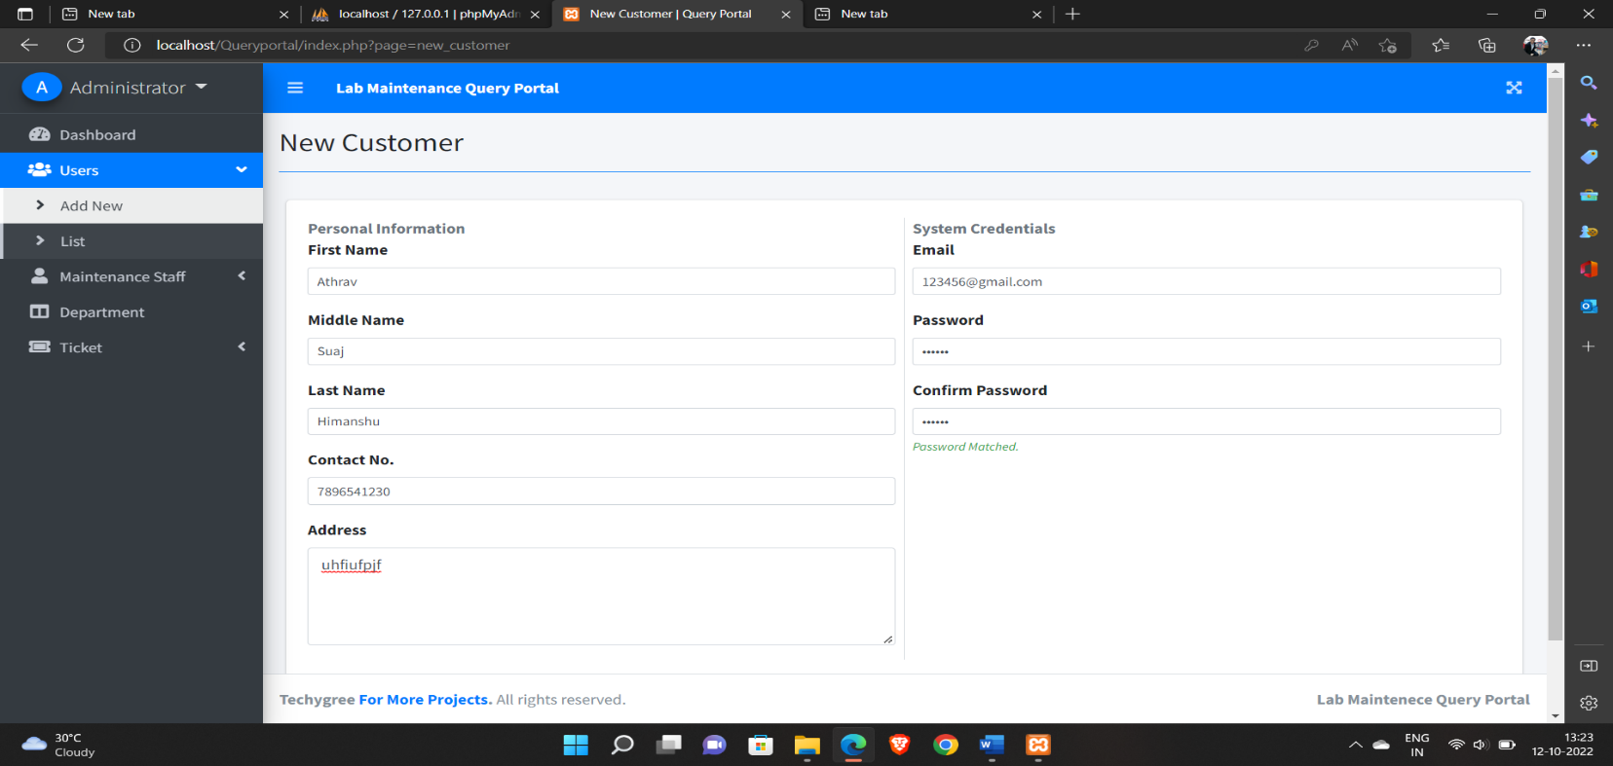

Slide 20
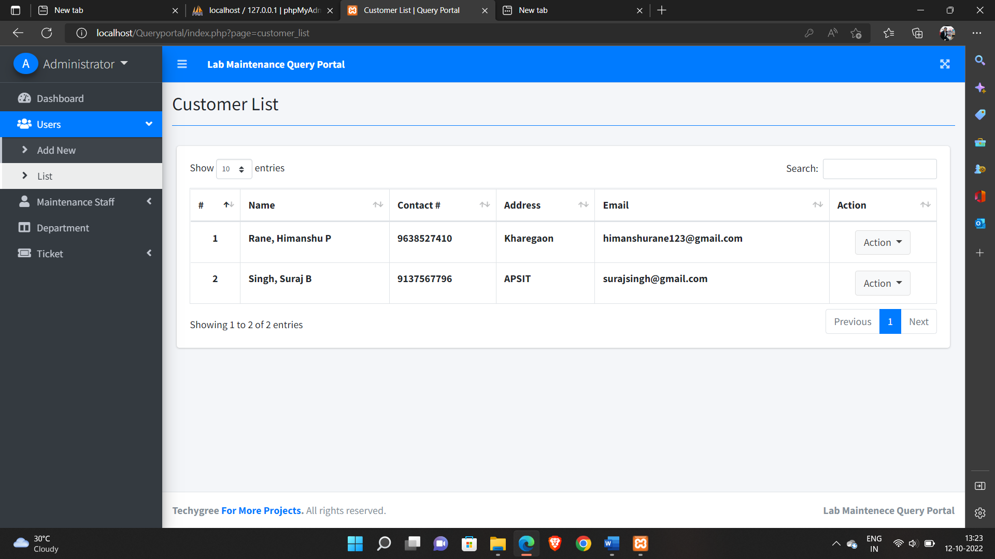
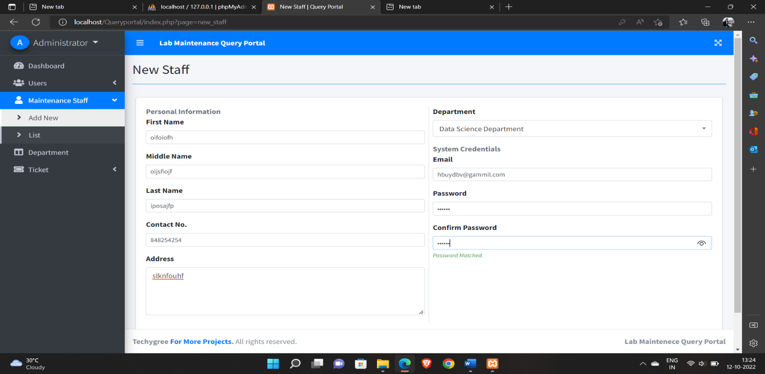

Slide 21
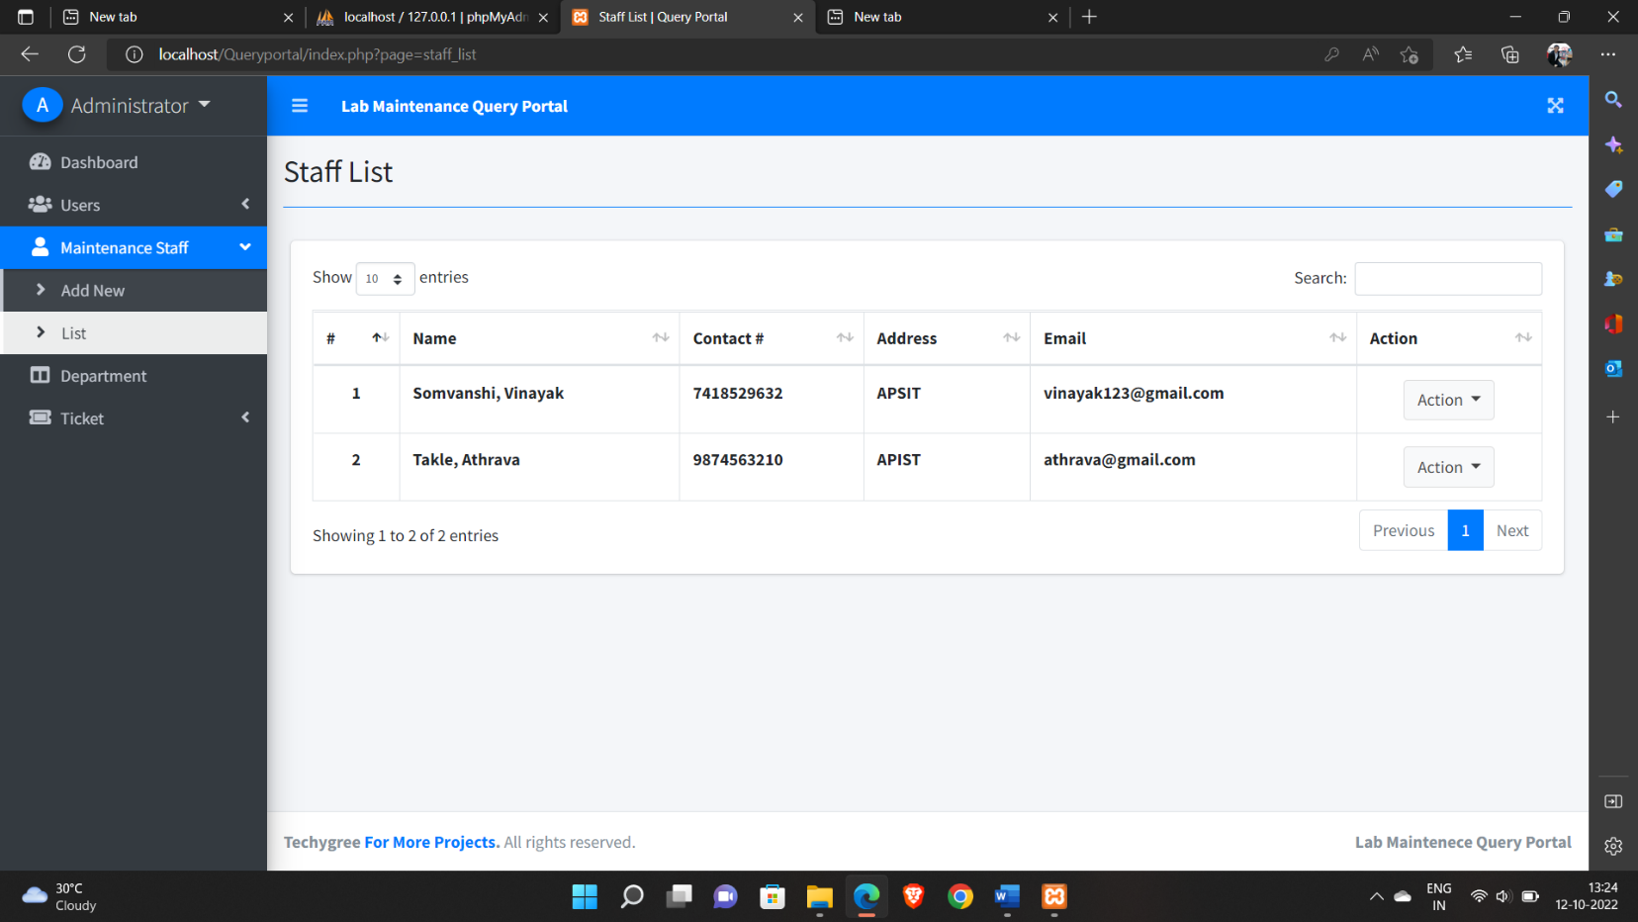
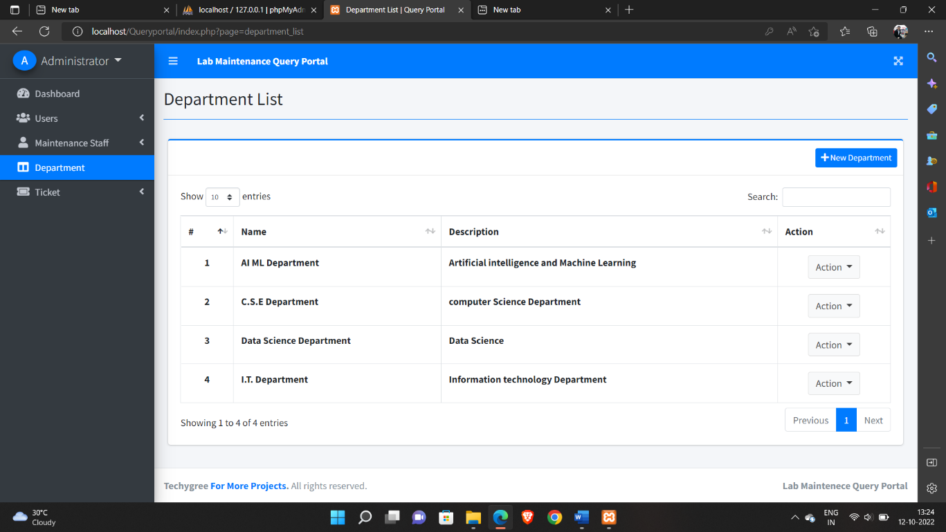

Slide 22
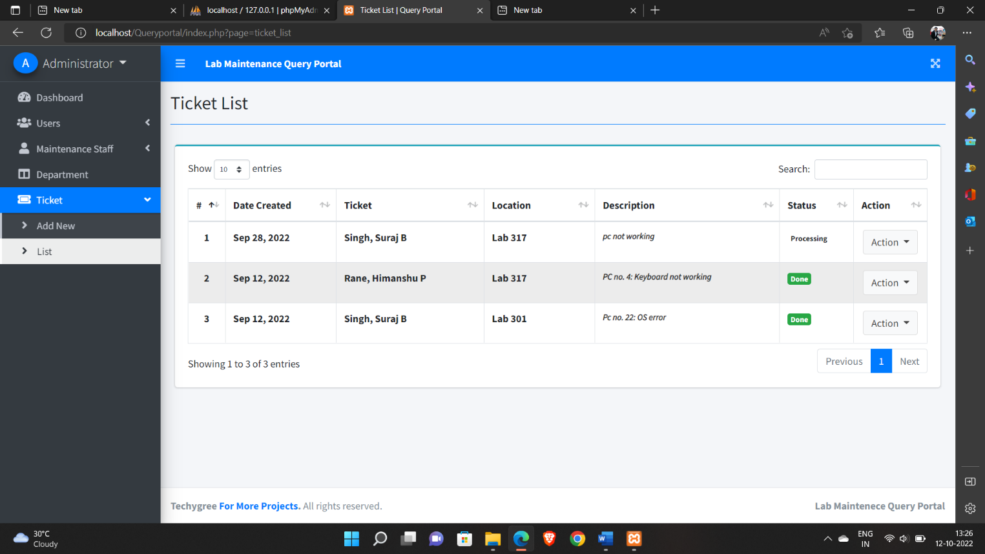
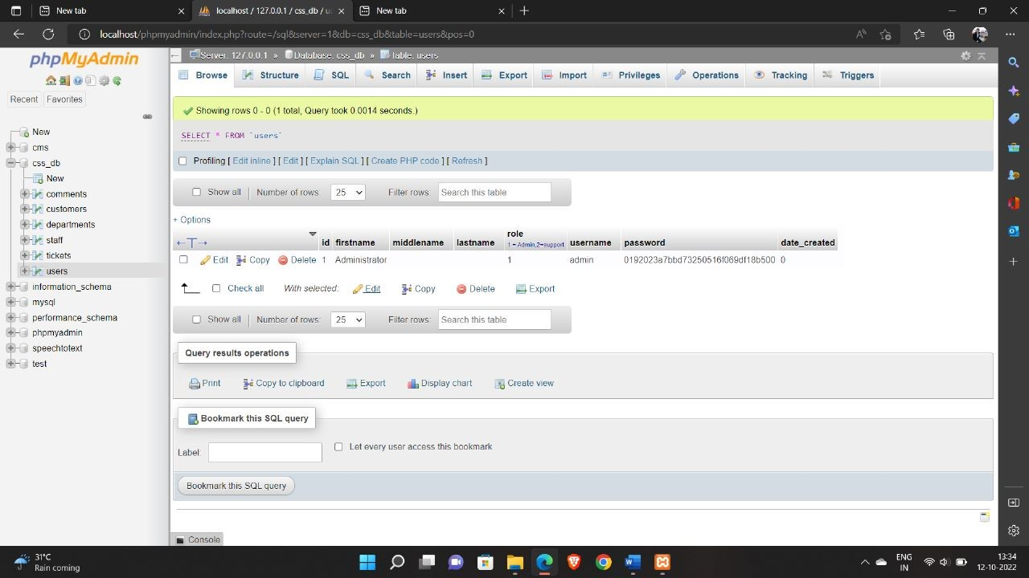

Slide 23
12. Conclusion
The web application aims at designing a application which will resolve online queries which are updated on the portal.
This helps to solve the query faster.
Admin will be able to view the complaints registered and solved.
The software will help to streamline the process of lab maintenance.
The future scope for the project is to enable user add image with query and enhance security of the project.

Slide 24
References
[1] Complaint Management System, International Research Journal of Engineering and Technology (IRJET), Volume: 04 Issue: 04 | Apr – 2017.
[2] Amrute, Ajinkya, "Cloud Based Complaint Management Service" (2013). Master's Projects. Paper 298
[3] The Implementation of Agent-based complaint Management System, IJCSNS International Journal of computer Science and Network Security, VOL.8 No.5, May 2008.
[4] Smart Complaint Management System, July 2018, DOI: 10.1109/ICT-ISP.2018.8523949, https://www.researchgate.net/publication/328834234
[4] Online complaint Management System in IN DBU ETHIOPIA July, 2008 E.C
[5] Coussement, K. & Van den Poel, D. (2008). Improving Customer Complaint Management by Automatic email Classification using Linguistic Style Features as Predictors, Decision Support Systems (44), 870-882
[6] Schiaffino, S. & Amandi, A. (2008) Building an Expert Travel Agent as a Software Agent. Expert System with Applications. Article in Press
[7] BROHMAN, M.K., et al., Data completeness: A key to effective net-based customer service systems. 2003
[8] Feng, L., The Research of The Property Service Enterprise’s Innovation Based on the Customer Relationship Management Theory, in 2015 8th International Conference on Intelligent Computation Technology and Automation. 2015, IEEE. p. 1022-1024
[9] Complaint system. 2017 [cited 2017 2]; Available form: https://en.wikipedia.org/wiki/complaint_systems.
[10] Customer Complaint. [cited 2017 2]; Available from: http://www.financepractitioner.com/dictionary/customer-complaint

Slide 25
Thank You...!!

